Slide 1



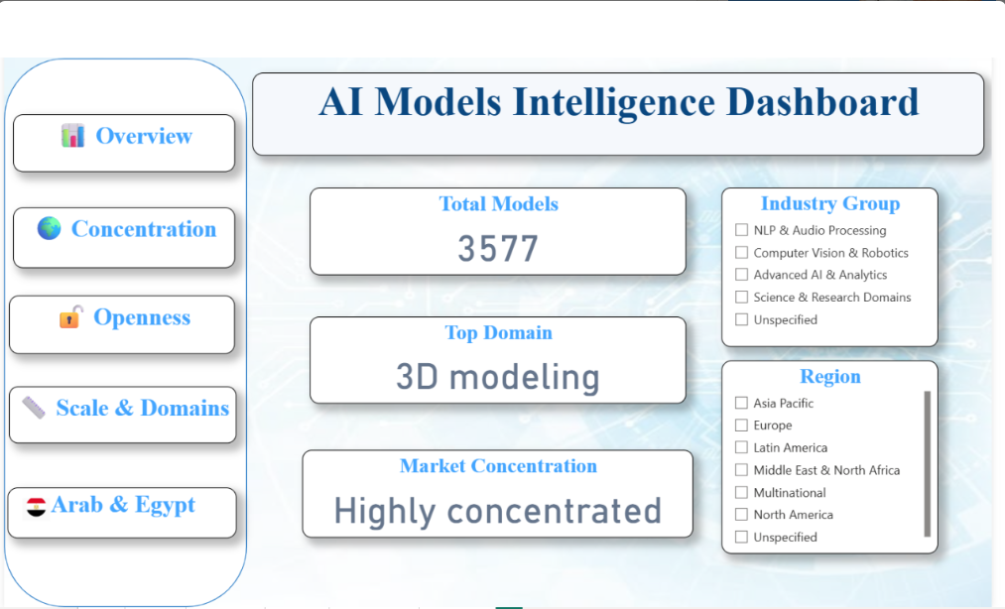
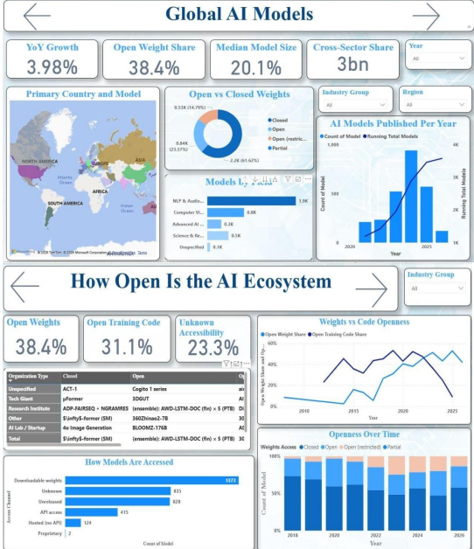
]
Digital Pioneers Initiative
DiGiLiANS — Junior Data Analysis
MCIT & Egyptian Military Academy | Capstone Project Defense — September 2026
Data-Driven Analysis of Global AI Compute Dependency and Arab AI Opportunities
Enterprise Business Intelligence Solution for Global Compute Mapping & Strategic National Decision-Support
Nermeen Ahmed
Mariam Samir
Menna Mohamed
Shrouq Mera
Shahd Mohamed
Amany Mohamed
Supervisor: Prof. Dr. Rania Elgohary
Track Head: Dr. Ahmed Zakaria
Academic Team: Dr. Yasser Ali
Instructor: Dr. Bassam Elshoura (YAT Company)
Track: Junior Data Analysis
ABSTRACT & AIM OF THE WORK
METHODOLOGY & SYSTEM ARCHITECTURE
RESULTS & KEY ANALYTICAL INSIGHTS
Engineered an enterprise Business Intelligence solution analyzing 3,577+ historical and modern AI model records (1957–2026). Built on a robust Star Schema with 38 custom DAX measures and Power Query ETL processing, the platform transforms raw compute metrics into actionable decision-support dashboards[cite: 1, 2].
Technical & Strategic Deliverables:
• Enterprise BI Architecture: Designed a 6-page interactive Power BI report evaluating global compute monopolization, hardware cost dynamics, and AI era evolution[cite: 1, 2].
• Strategic Aim: Empower Egyptian and Arab policymakers and investors to transition from passive consumers to active AI creators, supporting Egypt Vision 2030 and national digital sovereignty[cite: 1, 2].
• Investment Guidance: Provide data-driven insights for regional tech funds and state initiatives to optimize compute infrastructure investments and regional readiness[cite: 1, 2].
• Layer 1 – Data Ingestion: Raw ingestion of 3,577+ historical and modern AI model records (1957–2026) sourced from Epoch AI and specialized regional datasets.
• Layer 2 – ETL & Data Cleansing: Power Query (M Language) pipeline for structural deduplication, strict schema typing, dynamic missing-value management, and custom Zero-Imputation logic.
• Layer 3 – Data Modeling: Robust Enterprise Star Schema featuring 1 Central Fact Table (all_ai_models_FINAL) linked via 1-to-Many relationships to 4 Dimension Tables (Dim_Date, Dim_Country, Dim_Organization, Dim_Domain).
• Layer 4 – Analytics Engine: 38 custom DAX measures engineered for dynamic Herfindahl-Hirschman Index (HHI) compute concentration, YoY CAGR metrics, and complex Time Intelligence aggregations.
• Layer 5 – Presentation Layer: A 6-page interactive executive Power BI Dashboard designed for strategic analysis, dynamic cross-filtering, and decision support.
• Global Market Concentration (HHI): Automated HHI DAX calculations revealed high compute monopolization in training hardware and frontier AI models, dominating global FLOP expenditures[cite: 1].
• Model Openness & Accessibility Trends: Quantitative shift analysis tracking Open-Weights vs. Closed Proprietary models showed a widening compute gap in enterprise-grade LLMs[cite: 1].
• AI Era & Hardware Cost Economics: Evaluated historical trends across compute eras (1957–2026), highlighting exponential hardware capital expenditure growth alongside training cost scaling[cite: 1].
• Arab World & Egypt Strategic Readiness: Benchmarked regional compute capabilities, investment flows, and infrastructure readiness across Arab nations, identifying actionable opportunities for localized AI compute nodes to support Egypt Vision 2030[cite: 1].
• Interactive Decision Support: Delivered a 6-page Power BI dashboard enabling real-time scenario filtering for policymakers, tech VC funds, and infrastructure planners[cite: 1].
PROBLEM STATEMENT
SYSTEM OVERVIEW & DASHBOARD VISUALS
CONCLUSION
• Compute Monopolization: Extreme market concentration of AI training infrastructure, hardware capital expenditure, and frontier foundation models controlled by a limited cluster of global tech giants.
• Data Fragmentation & Quality Issues: High dispersion of historical and modern AI metrics (1957–2026) across disparate, unstructured repositories with inconsistent schemas and missing telemetry[cite: 1].
• Analytical Decision Bottlenecks: Reliance on manual spreadsheets causes slow decision velocity, calculation errors in dynamic metrics (e.g., HHI Index, YoY CAGR), and lack of scalable BI modeling[cite: 1].
• Regional Readiness Gap: Severe lack of centralized, data-driven visibility into Arab and Egyptian AI compute capacity, creating barriers for strategic national investments and policy planning[cite: 1].
• Sovereign Infrastructure Risk: Heavy dependency on foreign compute nodes threatens regional tech independence and limits alignment with strategic national initiatives like Egypt Vision 2030[cite: 1].
• Enterprise Intelligence Delivered: Engineered a scalable, data-driven BI solution converting 3,577+ raw AI records into a 6-page interactive Power BI dashboard.
• Strategic Decision Support: Replaced intuition-based planning with automated DAX metrics (HHI, CAGR) to guide infrastructure capital allocation and technology investments[cite: 1].
• National AI Advancement: Provided actionable roadmaps for policymakers and Tech VCs to localize specialized compute capacity and accelerate Egypt's digital sovereignty in alignment with Egypt Vision 2030[cite: 1].
DATASET & TOOLS USED
FUTURE WORK
• Datasets: Epoch AI (3,577+ records, 1957–2026) for global compute metrics & QIMMA Logs for Arab AI investments.
• ETL & Modeling: Power Query (M Language) for deduplication & Zero-Imputation; Enterprise Star Schema (1 Fact, 4 Dim Tables).
• Analytics & BI Stack: DAX Engine with 38 custom measures (HHI, CAGR) & Microsoft Power BI (6-Page Interactive Dashboard).
• Automated Real-Time Data Pipelines: Integrate direct API connectors with Epoch AI and live tracking repositories for continuous, automated dataset refreshing.
• Predictive Machine Learning Models: Develop predictive analytics models in Python to forecast compute demand, FLOPs growth trajectories, and GPU hardware cost trends[cite: 1].
• Explainable AI (XAI) & Scenario Modeling: Implement transparent decision-support layers to enable dynamic sensitivity analysis for public-sector investments[cite: 1].
• Regional Ecosystem Expansion: Broaden tracking parameters to cover additional MENA region datasets, local startup infrastructure capacity, and AI policy shifts[cite: 1].
• Advanced BI Enhancements: Integrate automated alerts and key risk indicators (KRIs) within Power BI to support real-time decision-making for policymakers[cite: 1].
6 interconnected dashboard views: Executive Overview, Training Compute & Hardware Dynamics, Model Openness & Accessibility, Market Concentration & HHI Analysis, Arab & Egypt AI Opportunities, and Detailed Record Explorer — with dynamic cross-filtering, multi-currency conversion, and automated drill-through.
References:
[1] Epoch AI Notable Systems Database (1957–2026) | [2] QIMMA Arab AI Benchmark & Investment Logs | [3] Microsoft Power BI & DAX Documentation | [4] Egypt Vision 2030 & MCIT Digital Strategy

